Slide 1


Braulio H Gutierrez Roldan
21 April 2024

Slide 2

Outline
Executive Summary
Introduction
Methodology
Results
Conclusion
Appendix

Slide 3
Executive Summary
Summary of methodologies
Data Collection through API
Data Collection with Web Scraping
Data Wrangling
Exploratory Data Analysis with SQL
Exploratory Data Analysis with Data Visualization
Interactive Visual Analytics with Folium
Machine Learning Prediction
Summary of all results
Exploratory Data Analysis result
Interactive analytics in screenshots
Predictive Analytics result

Slide 4
Introduction
Space X offers its Falcon 9 rocket launches at a notable price point of 62 million dollars on its website. This is substantially lower compared to other providers whose charges are over 165 million dollars per launch. A significant portion of these cost savings stems from Space X's ability to recycle the rocket's initial stage. Understanding whether this first stage can be landed is crucial, as it plays a pivotal role in determining the overall expenses of the launch. Such insights are invaluable, especially for any rival firms that may want to submit a competitive bid for launching services. The main aim of this initiative is to develop a computational model capable of accurately forecasting the chances of the first stage landing successfully.
The project seeks to unravel several queries:
What are the key factors that influence the successful landing of the rocket?
How do different elements interact and contribute to the likelihood of a successful landing?
What specific conditions must be met to facilitate a consistent and reliable landing program?

Slide 5

Section 1

Slide 6
Methodology
Executive Summary
Data collection methodology:
Create 3 funcionts to obtain From the link https://api.spacexdata.com/v4/rockets the data of Rocket, Launchpad, and payloads data, then from the same link and save in a data frame
Perform data wrangling
Identify the null data in the data frame and work with them
Perform exploratory data analysis (EDA) using visualization and SQL
Perform interactive visual analytics using Folium and Plotly Dash
Perform predictive analysis using classification models
We build different strategies to identify the correct model to predict the launch success

Slide 7
Data Collection
We gathered the necessary information through a combination of techniques. Initially, we made GET requests to the SpaceX API to retrieve the data. Following this, we used the .json() method to decode the received JSON content and then utilized the .json_normalize() function to structure this data into a Pandas DataFrame. Subsequent steps involved cleaning the data, filling any gaps where data might be missing, and ensuring its completeness. Moreover, we harnessed the power of BeautifulSoup to scrape Falcon 9 launch data from Wikipedia. The aim here was to meticulously extract the launch data embedded within the HTML tables, process this data to parse it accurately, and ultimately convert it into a DataFrame format conducive to thorough analysis.

Slide 8
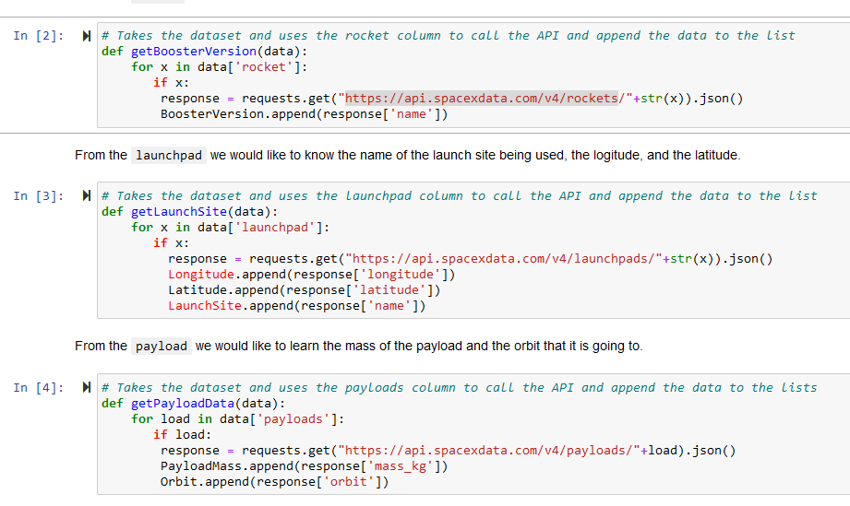
Data Collection – SpaceX API
Using the get request to collect data
https://github.com/pigeon0016/FinalDCMod10.git
Place your flowchart of SpaceX API calls here

Slide 9
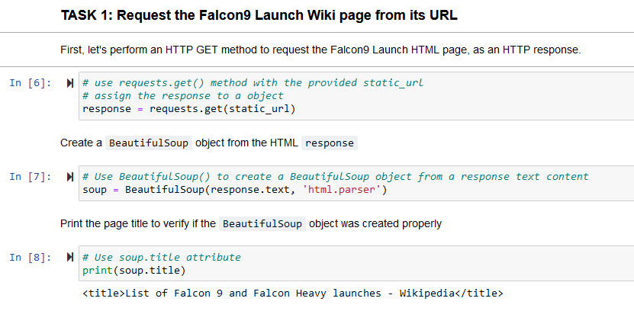
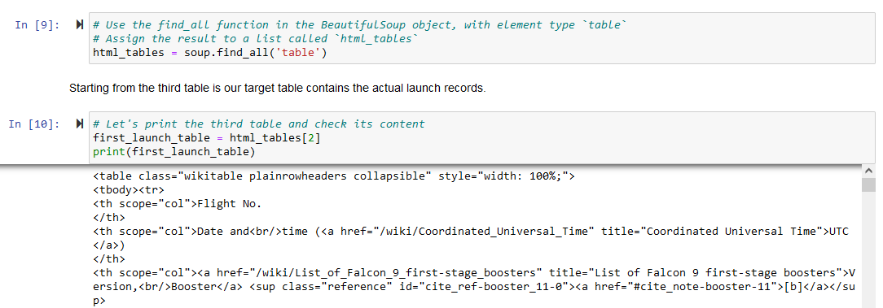
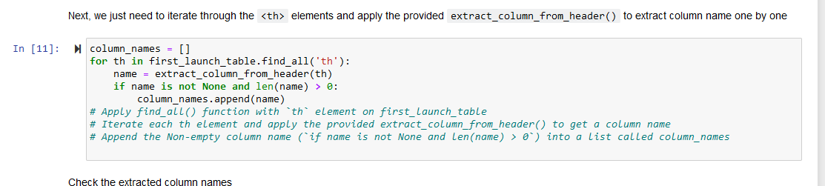
Data Collection - Scraping
Applied webscrapping to obtain data from falcon 9 with beautiful soap
https://github.com/pigeon0016/FinalDCMod10.git
Place your flowchart of web scraping here

Slide 10
Data Wrangling
During the preliminary phase, we conducted an exploratory analysis of the data to establish the labels needed for training our model. This included tallying the frequency of launches from each site as well as documenting the various orbits' occurrences. Furthermore, we synthesized a label for the landing outcome based on the data in the outcome column. The final step involved collating these insights and exporting them into a CSV file for future reference.
https://github.com/pigeon0016/FinalDCMod10.git

Slide 11
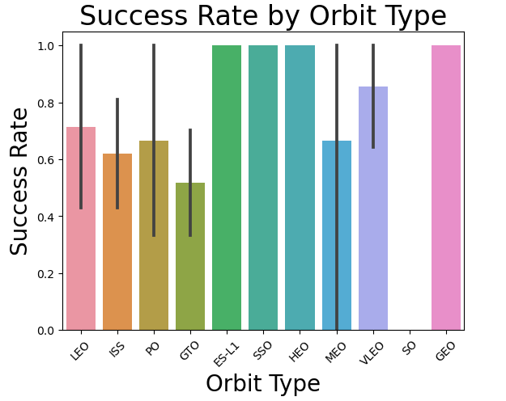
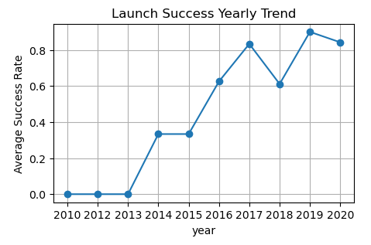
EDA with Data Visualization
We delved into the dataset by crafting visual representations to discern patterns between various elements: we plotted the correlation between the sequence of flights and their respective launch sites, examined the association between payload mass and launch sites, and analyzed the success rates correlated to each type of orbit. Additionally, we investigated the relationship between the flight sequence and orbit types, and charted the annual trends in launch successes to gain deeper insights.
https://github.com/pigeon0016/FinalDCMod10.git

Slide 12
EDA with SQL
We seamlessly integrated the SpaceX dataset into a PostgreSQL database directly from our Jupyter notebook environment. By employing SQL-based exploratory data analysis (EDA) within the notebook, we were able to derive valuable insights from the dataset. Specifically, we executed SQL queries to uncover unique details such as:
Identifying each distinct launch site involved in the space missions.
Calculating the cumulative payload mass ferried by the boosters on NASA (CRS) missions.
Determining the mean payload mass transported by the Falcon 9 version 1.1 boosters.
Counting the overall successful and unsuccessful mission outcomes.
Listing all unsuccessful landing attempts on drone ships, along with the associated booster versions and the names of the launch sites from which they were deployed.
https://github.com/pigeon0016/FinalDCMod10.git

Slide 13
Build an Interactive Map with Folium
We annotated all the launch sites on the folium map, incorporating various map elements like markers, circles, and lines to denote the outcomes of the launches from each site. We categorized launch outcomes into two classes: class 0 for failures and class 1 for successes.
Utilizing color-coded marker clusters, we were able to discern the launch sites with higher success rates. We meticulously measured the distances from each launch site to nearby points of interest. This allowed us to explore questions such as:
The proximity of launch sites to railways, highways, and coastlines.
Whether launch sites maintain a certain distance from populated areas for safety and security reasons.
https://github.com/pigeon0016/FinalDCMod10.git

Slide 14
Build a Dashboard with Plotly Dash
We constructed an interactive dashboard using Plotly Dash to visualize various aspects of the space missions. This dashboard includes pie charts that display the distribution of total launches from different sites. Additionally, we created scatter plots to illustrate the correlation between launch outcomes and payload mass in kilograms, taking into account the variations across different booster versions.
https://github.com/pigeon0016/FinalDCMod10.git

Slide 15
Predictive Analysis (Classification)
We initiated our analysis by importing the data utilizing libraries such as NumPy and Pandas. After transforming the dataset, we partitioned it into training and testing subsets for model evaluation. A range of machine learning models were then constructed, and their hyperparameters meticulously optimized with the aid of GridSearchCV. Our primary metric to gauge model performance was accuracy. To further refine our models, we applied techniques of feature engineering and algorithm tuning. Through this process, we were able to identify the classification model that delivered the most robust performance.
https://github.com/pigeon0016/FinalDCMod10.git

Slide 16
Results
Exploratory data analysis results
Interactive analytics demo in screenshots
Predictive analysis results

Slide 17

Section 2

Slide 18
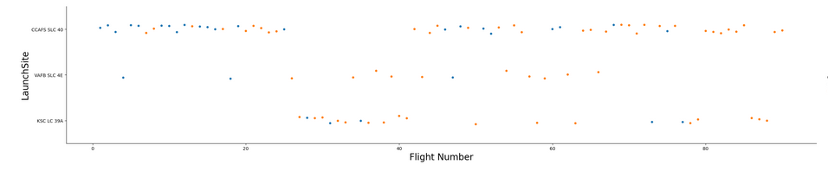
Flight Number vs. Launch Site
The large flught at the launch site has the success rate

Slide 19
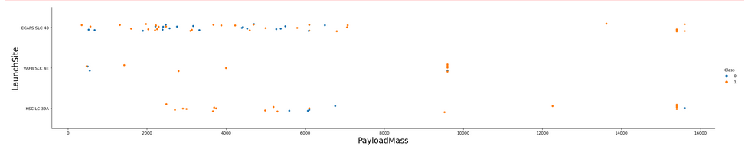
Payload vs. Launch Site
The VAFB SLC launchstite there are no rockets for heavypayload

Slide 20
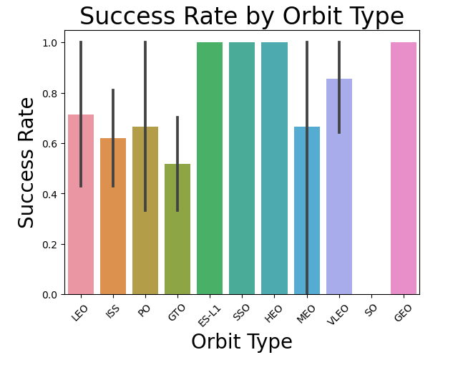
Success Rate vs. Orbit Type
The ESL1 sso and heo has the best success rate

Slide 21
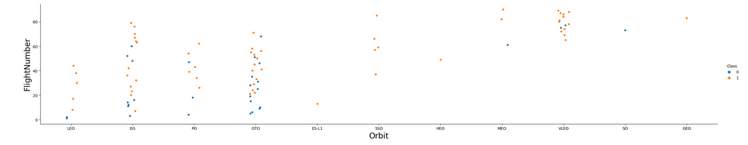
Flight Number vs. Orbit Type
the LEO orbit the Success appears related to the number of flights; on the other hand, there seems to be no relationship between flight number when in GTO orbit

Slide 22
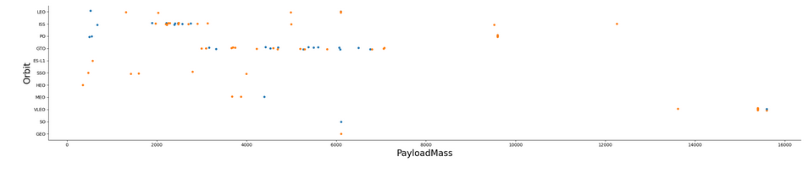
Payload vs. Orbit Type
With heavy payloads the successful landing or positive landing rate are more for Polar,LEO and ISS

Slide 23
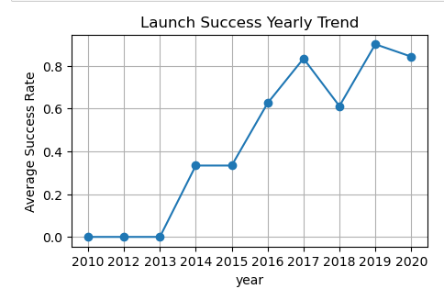
Launch Success Yearly Trend
the success rate since 2013 kept increasing till 2017 (stable in 2014) and after 2015 it started increasing

Slide 24
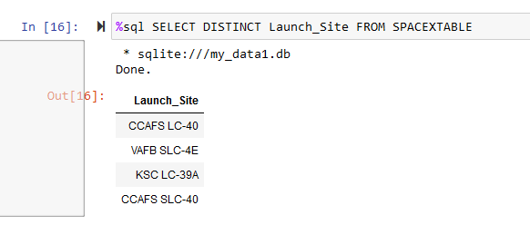
All Launch Site Names
Find the names of the unique launch sites
Present your query result with a short explanation here
All the sites names using SQL

Slide 25
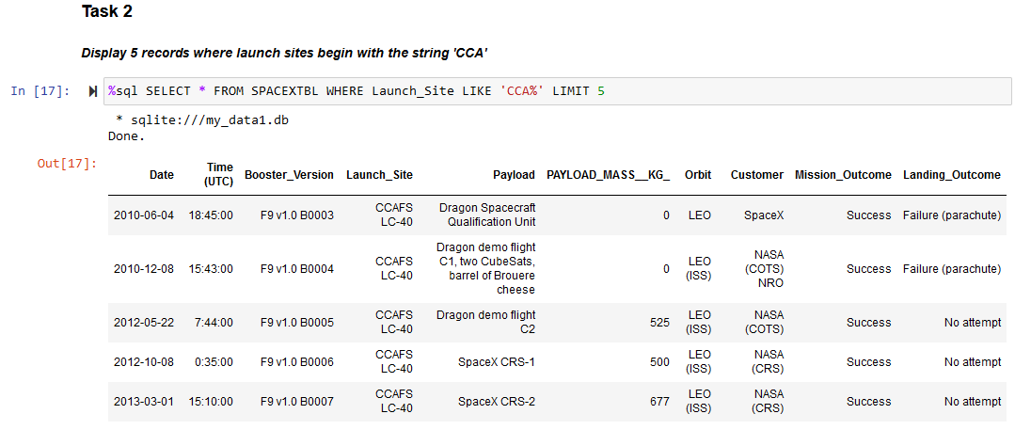
Launch Site Names Begin with 'CCA'
Find 5 records where launch sites begin with `CCA`
Present your query result with a short explanation here

Slide 26
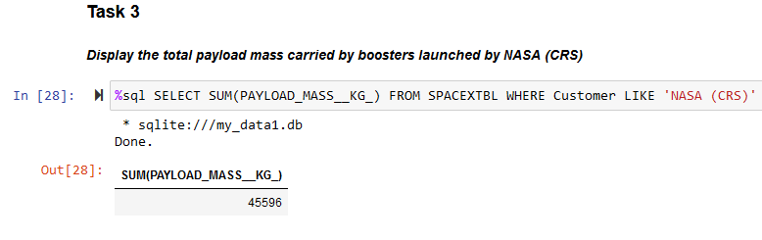
Total Payload Mass
Calculate the total payload carried by boosters from NASA
Present your query result with a short explanation here

Slide 27
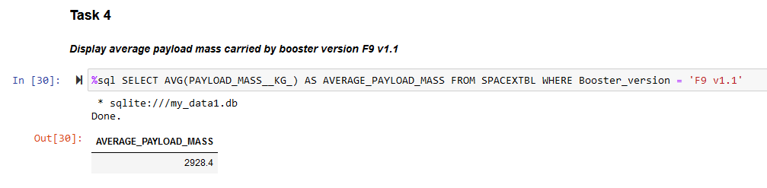
Average Payload Mass by F9 v1.1
Calculate the average payload mass carried by booster version F9 v1.1
Present your query result with a short explanation here

Slide 28

First Successful Ground Landing Date
Find the dates of the first successful landing outcome on ground pad
Present your query result with a short explanation here

Slide 29

Successful Drone Ship Landing with Payload between 4000 and 6000

Slide 30
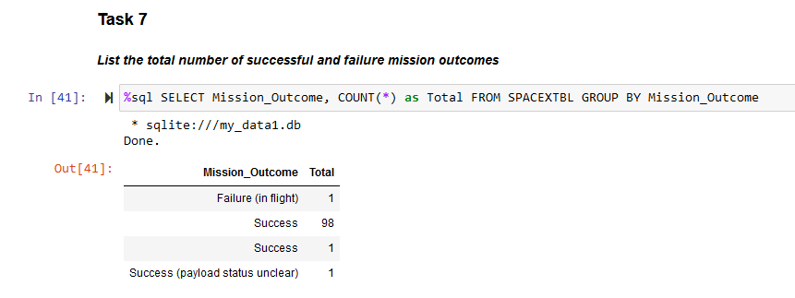
Total Number of Successful and Failure Mission Outcomes
Calculate the total number of successful and failure mission outcomes
Present your query result with a short explanation here

Slide 31
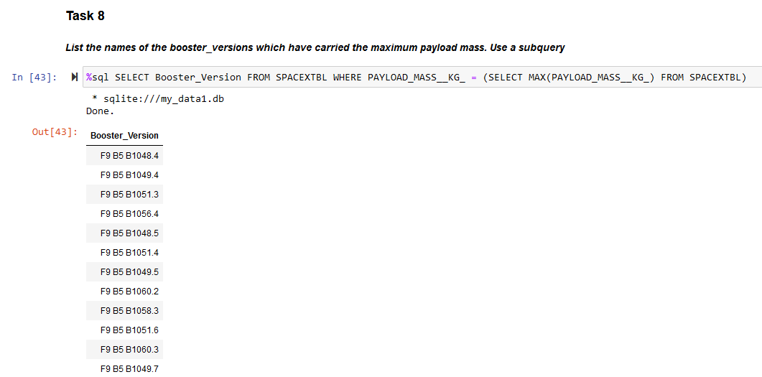
Boosters Carried Maximum Payload
List the names of the booster which have carried the maximum payload mass
Present your query result with a short explanation here

Slide 32
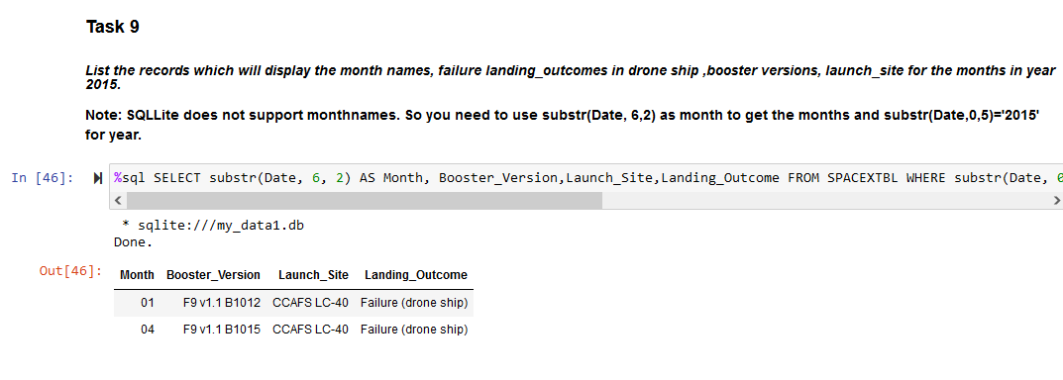
2015 Launch Records
List the failed landing_outcomes in drone ship, their booster versions, and launch site names for in year 2015
Present your query result with a short explanation here

Slide 33
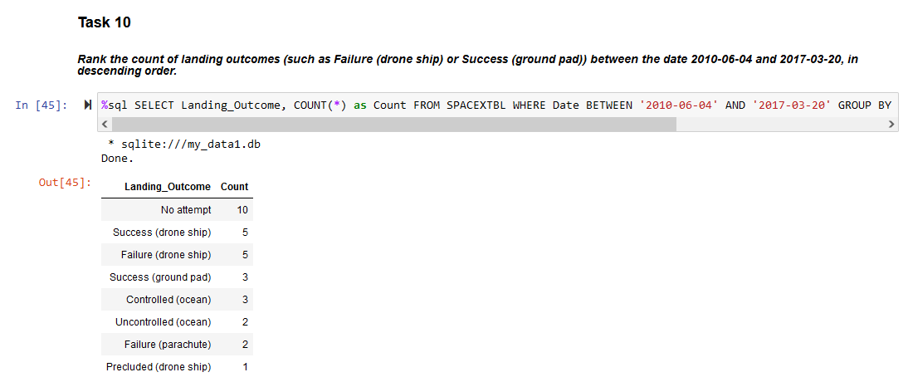
Rank Landing Outcomes Between 2010-06-04 and 2017-03-20
Rank the count of landing outcomes (such as Failure (drone ship) or Success (ground pad)) between the date 2010-06-04 and 2017-03-20, in descending order
Present your query result with a short explanation here

Slide 34

Section 3

Slide 35
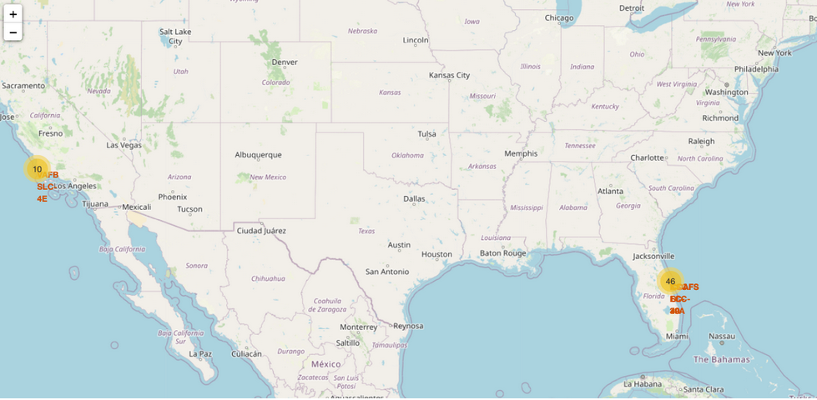
All launch sites
Replace <Folium map screenshot 1> title with an appropriate title
Explore the generated folium map and make a proper screenshot to include all launch sites’ location markers on a global map
Explain the important elements and findings on the screenshot

Slide 36
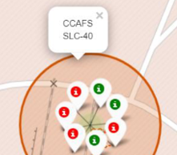
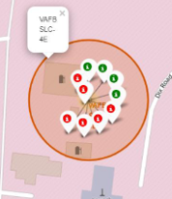
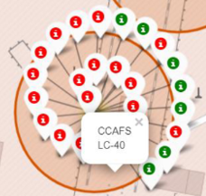
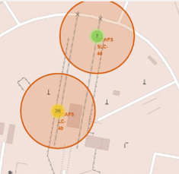
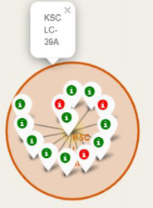
Launch sites

Slide 37
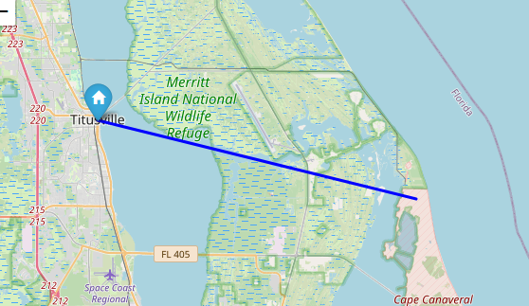

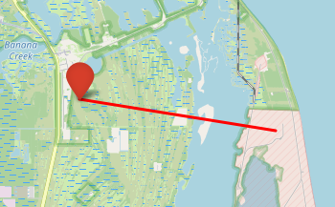
Distances from lounch site
Near City
Near highway
Near railway

Slide 38

Section 4

Slide 39
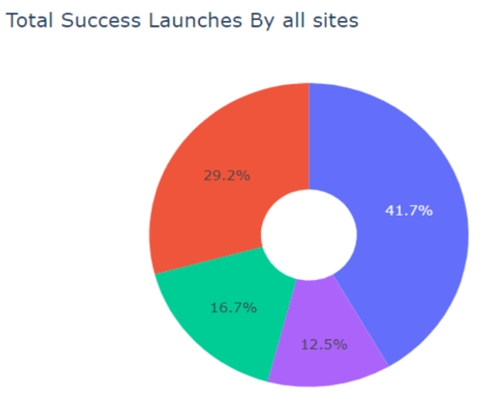
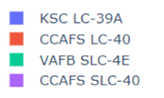
Pie chart of success

Slide 40
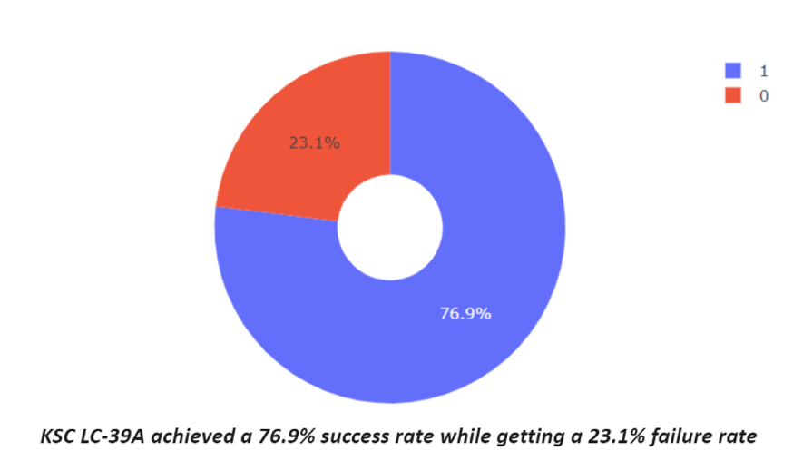
Launch site with highest launch success ratio

Slide 41
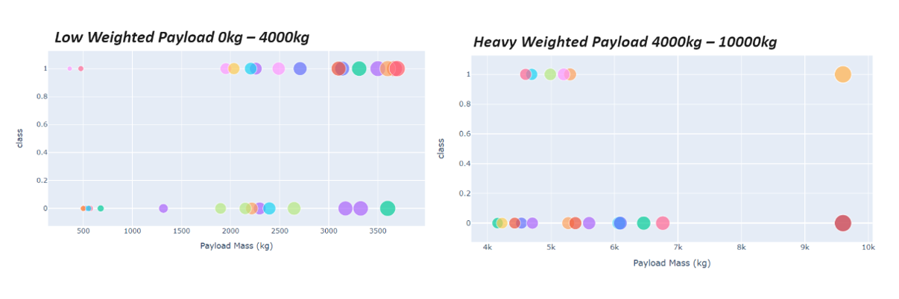
Payload vs launch outcome for all sites

Slide 42

Section 5

Slide 43
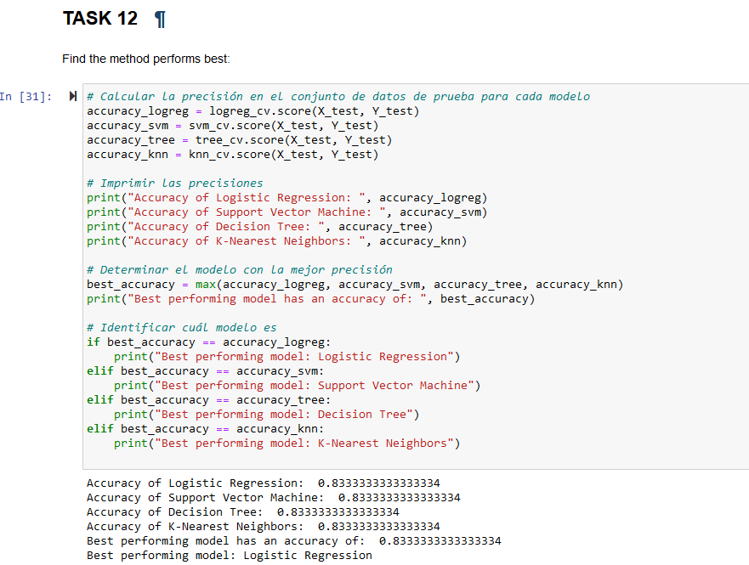
Classification Accuracy
Visualize the built model accuracy for all built classification models, in a bar chart
Find which model has the highest classification accuracy

Slide 44

Confusion Matrix
The confusion matrix generated for the decision tree classifier illustrates its capability to differentiate between various classes. However, a notable issue is the occurrence of false positives, wherein unsuccessful landings are incorrectly identified as successful by the classifier.

Slide 45
Conclusions
In summary, it can be inferred that:
A higher frequency of flights at a given launch site correlates with an elevated success rate for launches from that site.
There has been a steady rise in launch success rates from 2013 through 2020.
Orbits designated as ES-L1, GEO, HEO, SSO, and VLEO demonstrate the highest rates of successful launches.
The launch site KSC LC-39A boasts the highest number of successful launches compared to other sites.
For the task at hand, the Decision Tree Classifier emerges as the most effective machine learning model.

Slide 46


